Slide 1
Laparotomy (celiotomy )
Practical lecture
University of Basrah /College of veterinary medicine
5th stage
Dr.Alaa A. Ahmed

Slide 2
ANATOMY OF THE ABDOMINAL WALL
The abdominal wall confines the abdominal organs within the largest cavity in the body, extending from the diaphragm to the pelvic canal
linea alba is thick white band form from Fibers of the tendinous aponeuroses of the external abdominal oblique, internal abdominal oblique, and transverse abdominal muscles converge and join on midline
The linea alba is located between the rectus abdominis muscles.

Slide 3
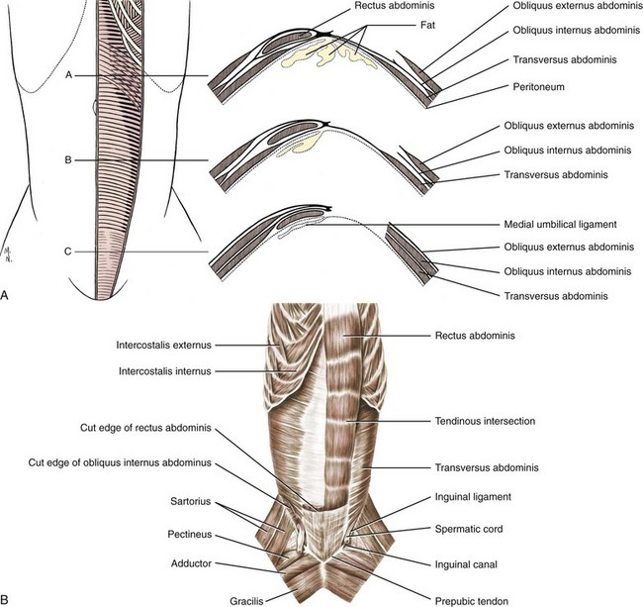

Slide 4
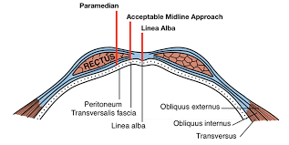
Muscles found in linea alba
Linea alba(midline) thick white band located between the rectus abdominis muscles (no muscle found )

Slide 5
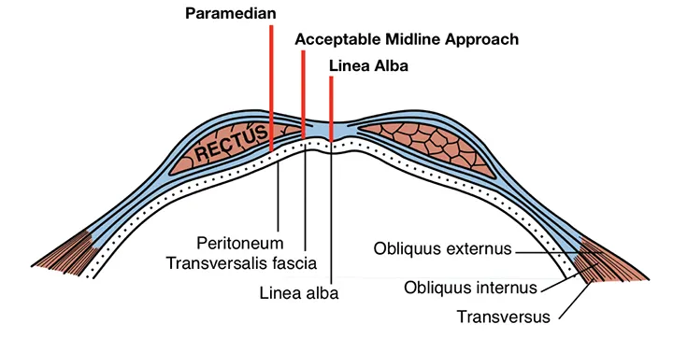
Muscles found in paramedian
Rectus abdominis muscle

Slide 6
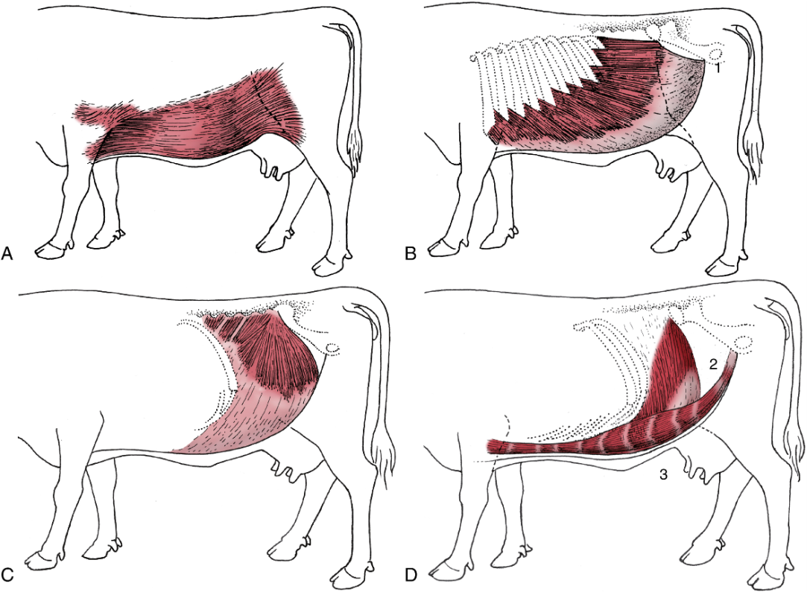
Muscles found in flank
External abdominal oblique
Internal abdominal oblique
Transverse abdominal muscles

Slide 7
Laparotomy
Is a surgical incision into the abdominal cavity
Indications of laparotomy :-
Exploratory laparotomy :performed to examine the abdominal organs and aid diagnosis of any problems
For Surgical intervention to treat surgical pateint (C.S, Abomasal displacement , rumenotomy ,OHE, ect)
For research purpose

Slide 8
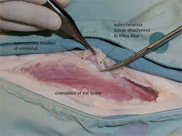
Surgical techniques of laparotomy
Linea alba (midline ) incision : is easy techniques used to enter the abdominal cavity
Commonly used in equine and small animals and rarely used in ruminants
Tissue layers which incised during linea alba incision approach include the following:
Skin
Subcutaneous tissue
Subcutaneous fat in fatty animal
Linea alba
peritoneum

Slide 9
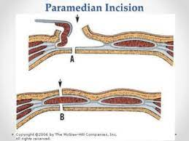
2- Paramedian (left or right ) incision : used in large and small animals (common)
Tissue layers which incised during Paramedian incision approach include the following:
Skin
Subcutaneous tissue
Rectus abdominis muscle
Peritoneum

Slide 10
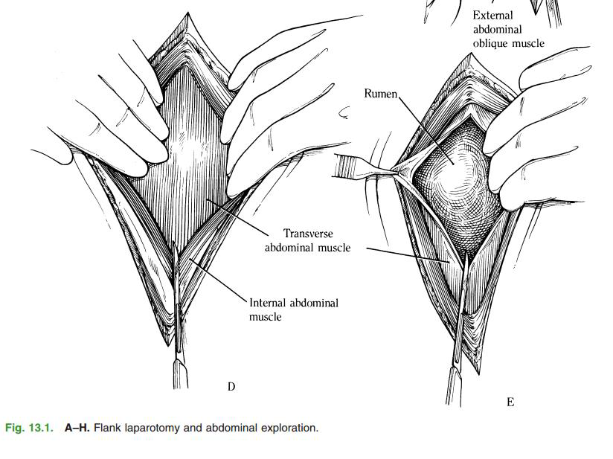
3- Flank (left or right , high or low )incision : is commonly used in ruminants and rarely used in small animals and equine
Tissue layers which incised during Paramedian incision approach include the following:
Skin
Subcutaneous
External abdominal oblique
Internal abdominal oblique
Transverse abdominal muscles
Peritoneum

Slide 11
Complications of laparotomy
Surgical site infection or inflammation
Peritonitis
Dehiscence
Pain
Seroma formation.

